Slide 1
Treatment
Diabetic Foot Ulcer (DFU)
S. Morrell NP MClSc-wound healing

Slide 2
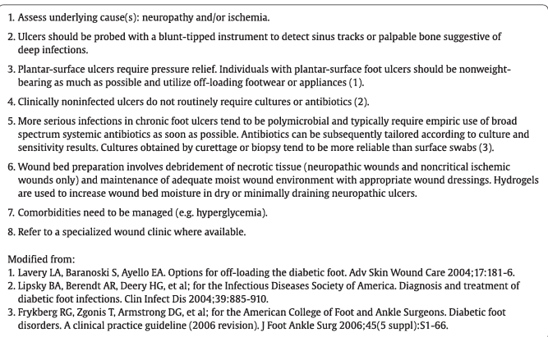
Treatment Diabetic foot ulcers
Diabetes
Canada
Notes:
Shttps://guidelines.diabetes.ca/GuideLines/media/Docs/cpg/Appendix-14.pdfource

Slide 3
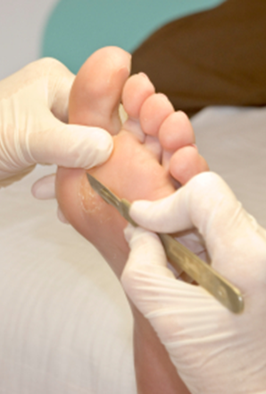
Diabetic ulcer-treatment
Foot care and callus removal by qualified health care provider
Offloading devices to alleviate pressure areas to promote healing of ulcers

Slide 4
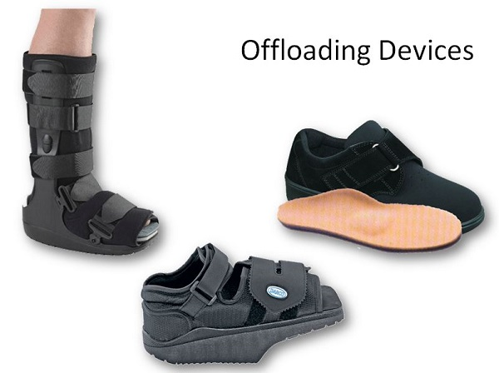
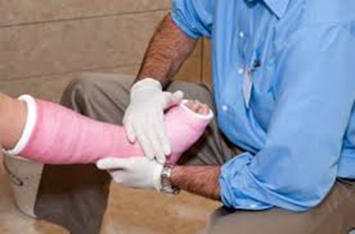
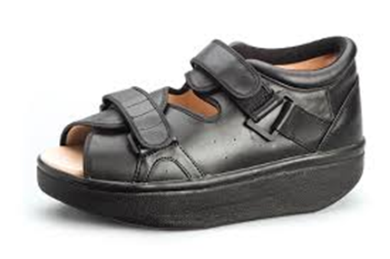
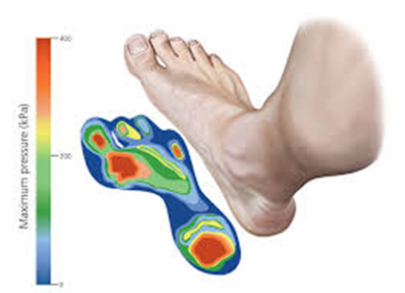

Slide 5
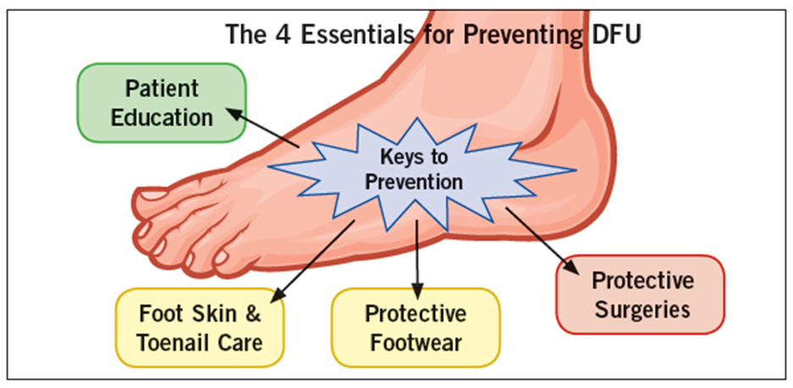
Prevention of DFUs (this is key!!!)

Slide 6
Diagnostic- Lab (monitor end organ damage)
Glucose control HbA1C q 3 months
Monitor- Renal (kidney disease)
  Albumin/creatinine ratio-
    First morning urine sample
    normal ACR <2 mg/mmol
  Glomerular filtration rate
    serum blood test
    calculation using- blood creatinine test, age, body size and gender
    normal >60 ml/min First-morning

Slide 7
Diagnostic- Lab (monitor end organ damage)
Dyslipidemia
fasting lipid levels(TC, HDL, TG & calculated LDL
LDL </= 2 mmol/L
Coronary artery disease (CAD) ECG-baseline & q2years ECG

Slide 8
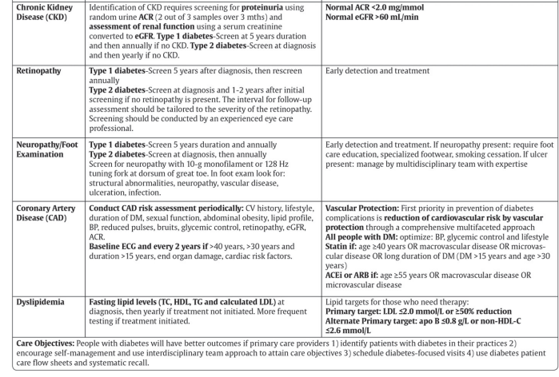
Screening Ranges

Slide 9
Dietician
Diabetic Wellness
Orthotics-offloading (CCAC –covered)
Foot care
Referrals required

Slide 10
References
  Diabetes Canada Clinical Practice Guidelines Expert Committee. Diabetes Canada 2018 Clinical Practice Guidelines for the Prevention and Management of Diabetes in Canada. Can J Diabetes. 2018;42(Suppl 1):S1-S325.
Orsted, H.L. & Rosenthal, S. (2021). Foundations of Best Practice for Skin and Wound Management. Wounds Canada. Ebook Available to purchase at https://www.woundscanada.ca/eboutique and the code for 25% discount on the ebook is UWNursing

